Slide 1
U.S. Interagency Council on Homelessness
All In: The Federal Strategic Plan to Prevent and End Homelessness

Slide 2
About USICH
Only federal agency solely dedicated to ending homelessness
Coordinates federal response across 19 federal agencies to help create and catalyze implementation of a federal plan
Works with all levels of government and partners in the private sector and philanthropy to advance most efficient and effective strategies
Notes:
Alec

Slide 3
USICH Council
Council leaders:
Chair – HHS Secretary Xavier Becerra
Vice Chair – USDA Secretary Tom Vilsack
Council members represent 19 federal agencies:
Notes:
Alec

Slide 5
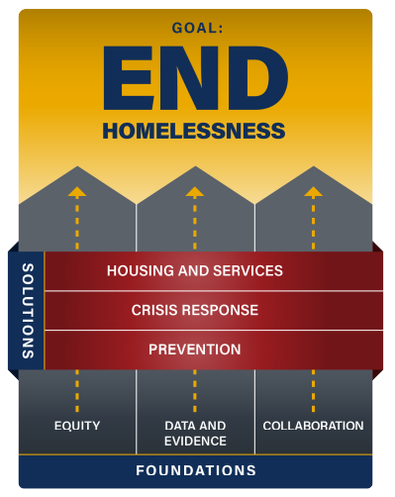

Slide 6
Using the framework of the All In plan, the table below provides a roadmap for communities to develop and implement a humane and effective response to encampments. Each strategy is described in greater detail in the sections that follow.
COLLABORATION | CRISIS RESPONSE
Establish a Cross-Agency, Multi-Sector Response Empower Outreach Teams and Health Providers to Lead the Effort Determine Whether Closure Is Necessary Engage Neighboring Residents and Businesses | Address Basic Needs and Provide Health Care Conduct Comprehensive, Coordinated, and Ongoing Outreach Provide Storage Improve Safety of Site
EQUITY | HOUSING & SUPPORT
Center Encampment Residents in Efforts to Develop Solutions Address Unique Needs of People With Chronic and Acute Health Conditions Emphasize Accessibility and Inclusivity of Site | Ensure Access to Housing and Services Ensure Interim Strategies Promote Dignity, Respect, and Pathways to Permanent Housing Develop Pathways to Permanent Housing and Support If Necessary, Implement Humane Encampment Closure
DATA & EVIDENCE | PREVENTION
Collect and Share Data Track Shelter and Housing Availability Track Status of People Housed and Yet to Be Housed | Expand Affordable Housing and Address Other Root Causes of Unsheltered Homelessness

Slide 7
How All In Can Be Used Locally
Develop local and systems-level plans
Set state and local goals to reduce homelessness by 2025
Educate partners on the causes of homelessness, challenges, and opportunities
Hold the federal government accountable
Learn about federal programs, existing federal actions, and new federal strategies

Slide 8
All INside
ALL INside is a first-of-its kind initiative to address unsheltered homelessness across the country. On May 18, 2023, federal, state, and local leaders came together to launch ALL INside.
The White House, USICH, and the 19 federal agencies that make up our council are partnering with select state and local governments to strengthen and accelerate local efforts to help people move off the streets and into homes where they can recover from the trauma of homelessness and rebuild their lives.
Notes:
ALL INside is a first-of-its kind initiative to address unsheltered homelessness across the country. On May 18, 2023, federal, state, and local leaders came together to launch ALL INside, including Ambassador Susan Rice, the president’s domestic policy advisor; Veterans Affairs Secretary Denis McDonough, the chair of USICH; USICH Executive Director Jeff Olivet; and mayors and other elected officials from across the country.
The White House, USICH, and the 19 federal agencies that make up our council are partnering with select state and local governments (see full list of communities below) for up to two years to strengthen and accelerate local efforts to help people move off the streets and into homes where they can recover from the trauma of homelessness and rebuild their lives.
https://www.usich.gov/all-inside/

Slide 9
Visit usich.gov/all-in

Slide 10
Katy Miller
Senior Regional Advisor
U.S. Interagency Council on Homelessness
Katy.Miller@USICH.gov

